Slide 1

SPACY: Satellite Prediction of Aggregate Corn Yield
Yuval Epstain Ofek & Richard Lee
Notes:
Crops: https://lh3.googleusercontent.com/proxy/x08NambK-45O03mFd1eK4CPmaG3gLpQVzTGjlDF4dxkDVpARI6h5ThRXJft9m8Qrxxevk1eIUMoux_Q1O-yNdczV_4ERLzH8Jm4J2XM

Slide 2
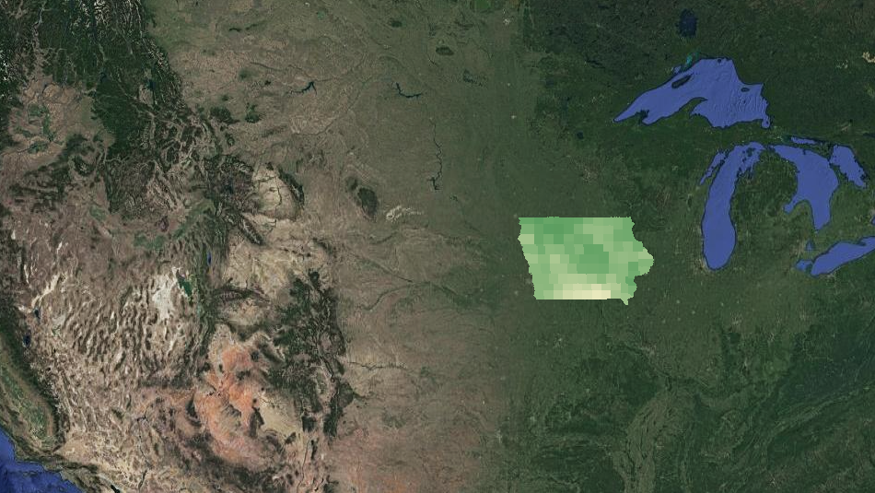
Project Goals
Predict good locations to plant corn based on how likely these locations are to ‘
increasing aggregate yield .
2012 Yield
Notes:
Map: https://static01.nyt.com/images/2020/03/29/us/iowa-coronavirus-cases-promo-1585539039190/iowa-coronavirus-cases-promo-1585539039190-superJumbo-v134.png
(actually abt covid, but it shows a point)

Slide 3
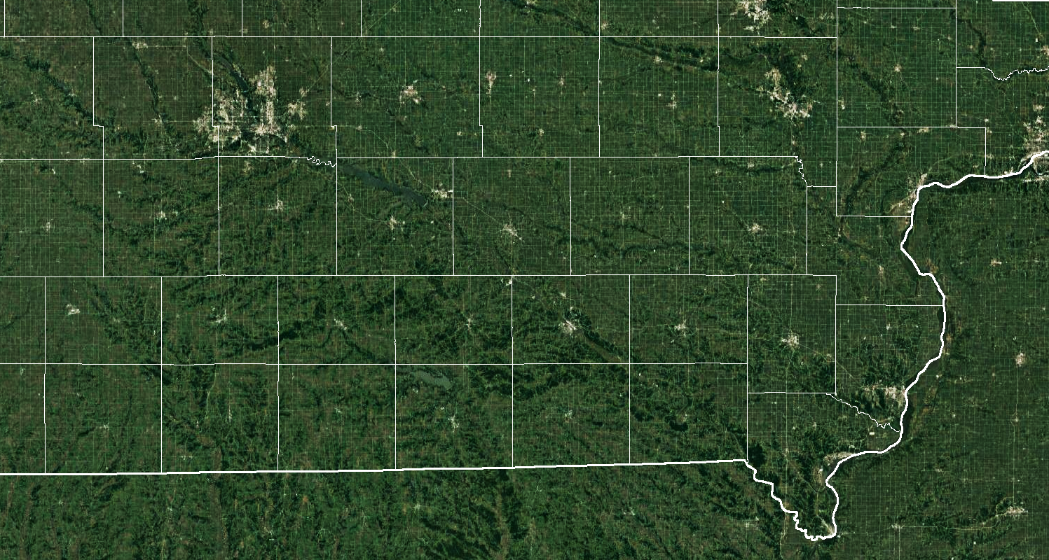
Concerns
How do we stop current crop location from biasing our analysis?
The yield data is on a county basis, how can we use that to create a pixel-based heatmap?
Notes:
Richard: The first issue is that Iowa already has crops, so if we use something like spectral data as input, as that would bias our results.

Slide 4
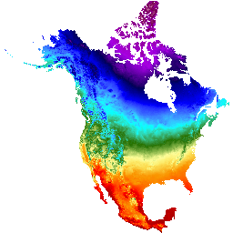
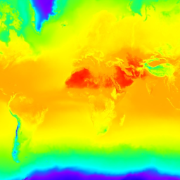
Our Solutions
Stop Crop-bias:
Only use environmental factors (daylight, temperatures, vapor pressure, etc.), as those are independent from whether crops are present
ERA5 Daily aggregates - Latest climate reanalysis produced by ECMWF / Copernicus Climate Change Service
Daymet V4: Daily Surface Weather and Climatological Summaries

Slide 5
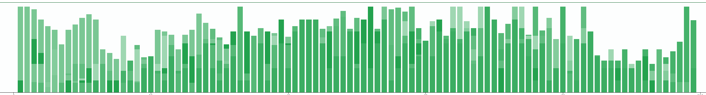
Our Solutions
Generalize to pixel-based predictions:
Convert input to histograms
At training take histogram of all crop pixels & at evaluation take pixel-wise histograms
Normalized Band Histograms
Notes:
Richard: Can consider the histogram as a probability distribution, and if we see this same distribution when looking at the temporal histogram of a pixel, we can find whether it is good for crops

Slide 6
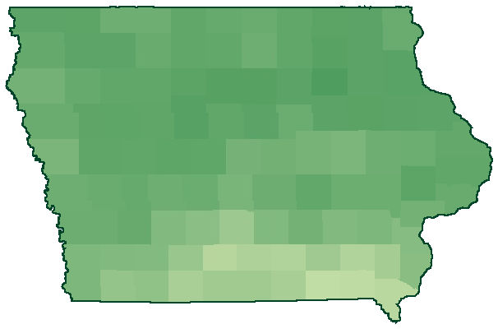
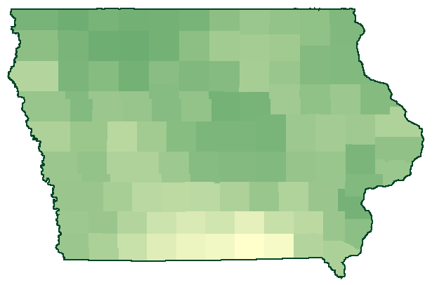
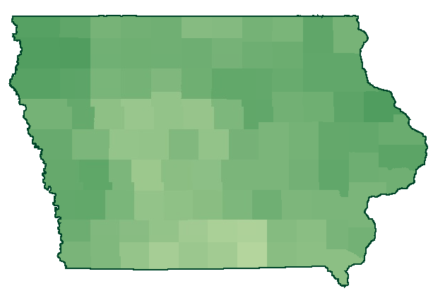
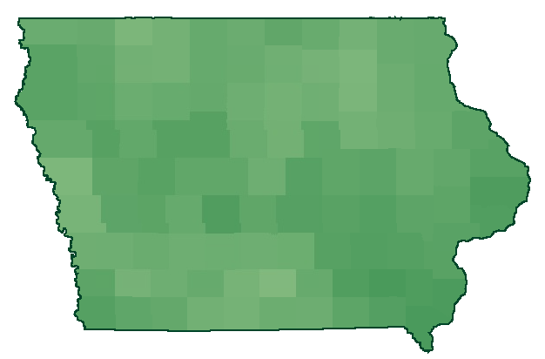
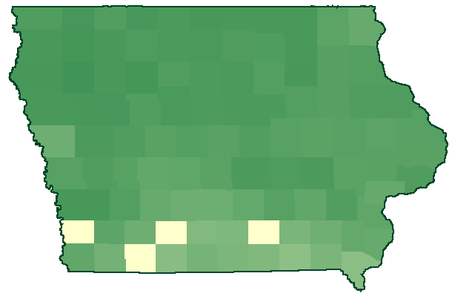
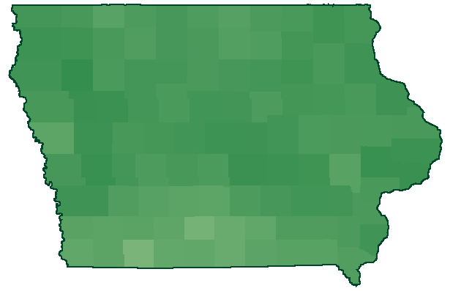
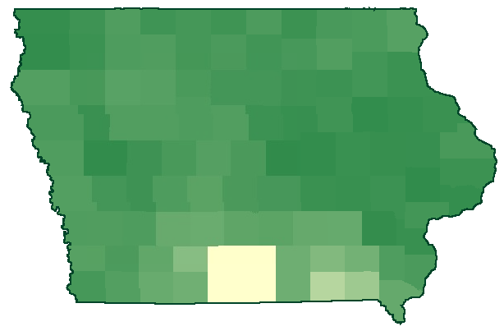
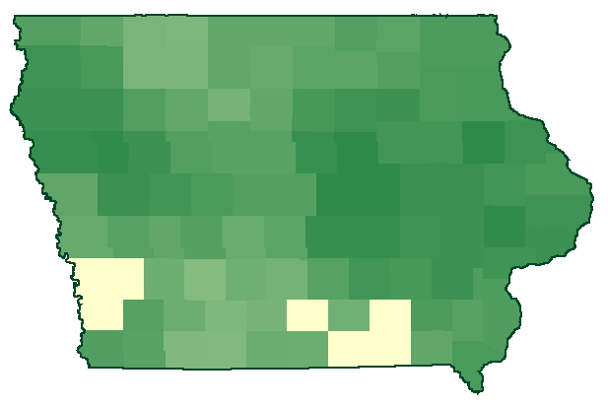
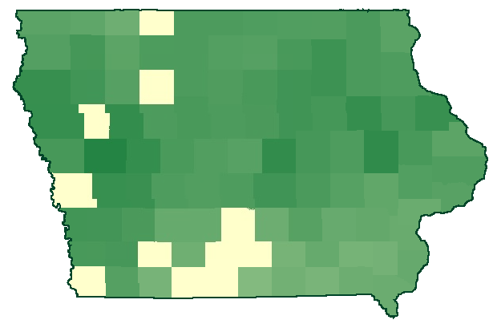
Corn yield data (labels) - bushels/acre
2011
2012
2013
2014
2015
2016
2017
2018
2019
Data from: https://www.extension.iastate.edu/agdm/crops/pdf/a1-12.pdf
Notes:
https://code.earthengine.google.com/57668c42aaddac4f1e3333288b4286f3

Slide 7
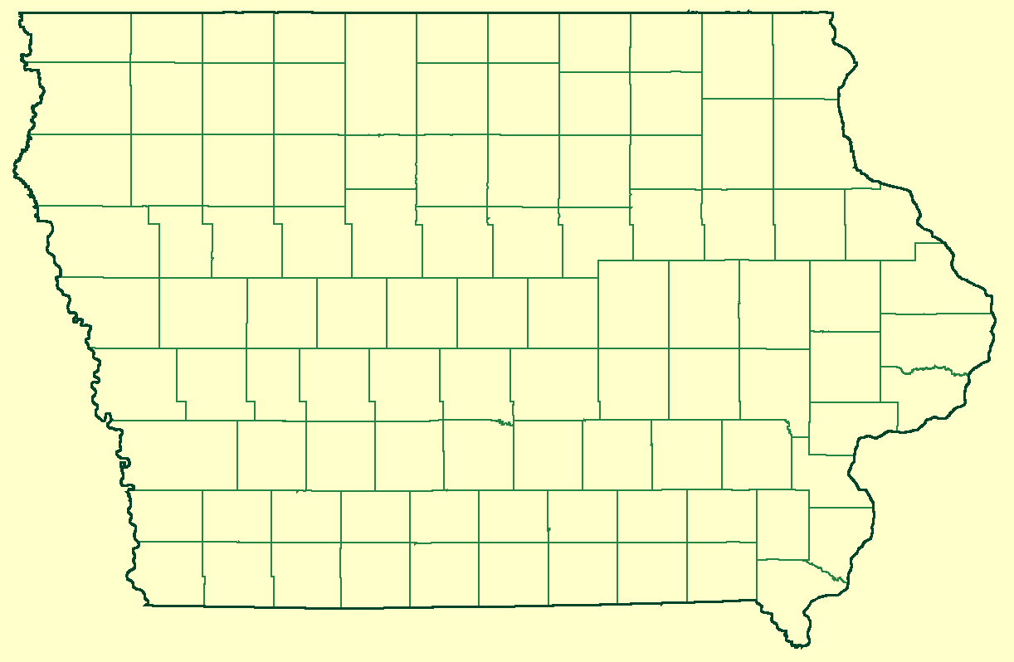
Counties and States (Vector Data)
TIGER: US Census States 2018
TIGER: US Census Counties 2018
Notes:
Richard: If we are focusing on Iowa over 7 years, then we would only have 7 data points, which really isn’t that much, so we decided to look at counties - large enough that we have aggregate yield, large enough that it yield sufficiently many data points

Slide 8
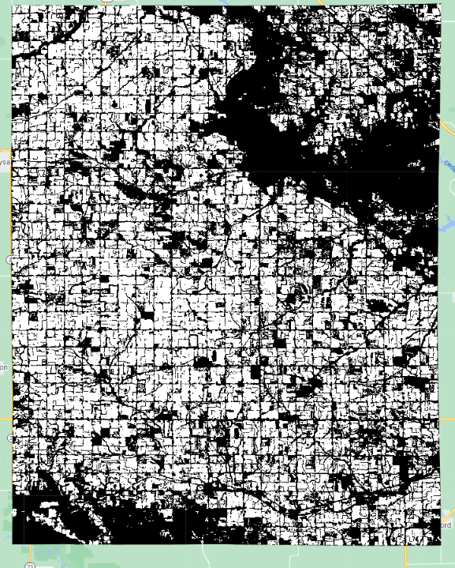
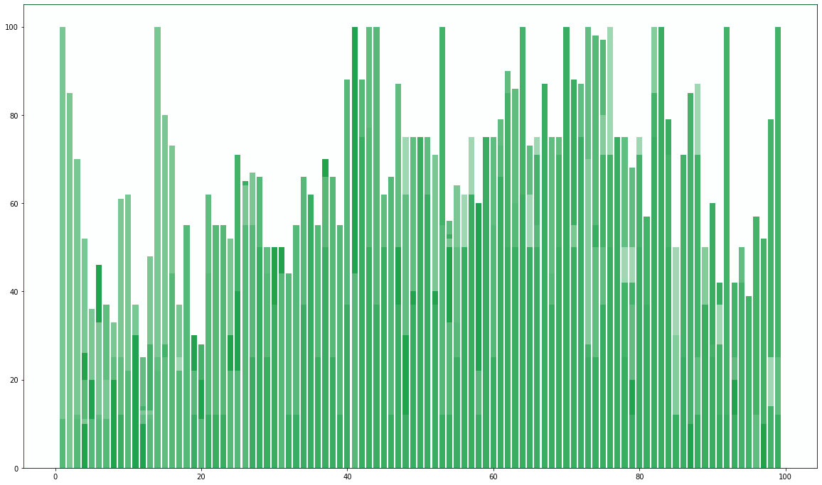
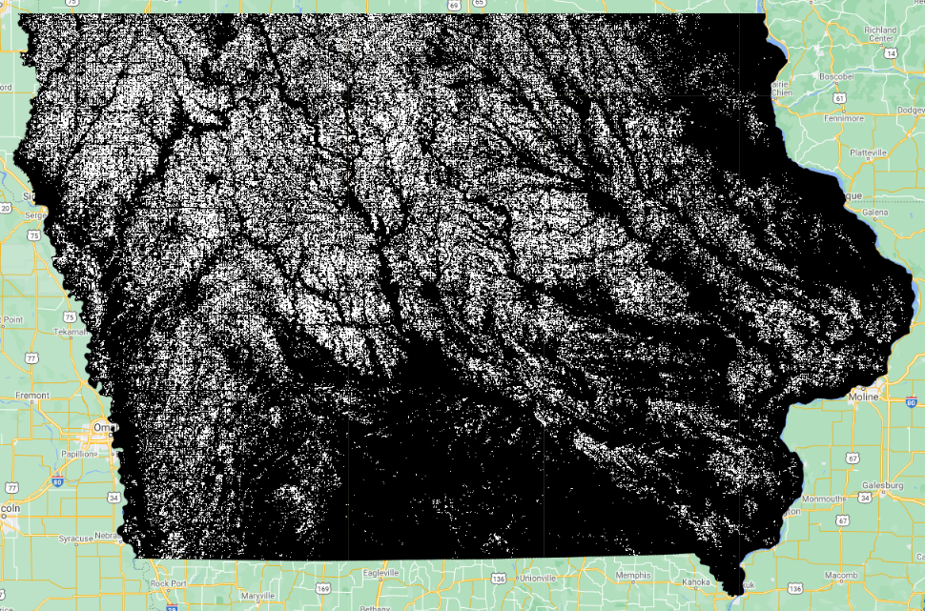
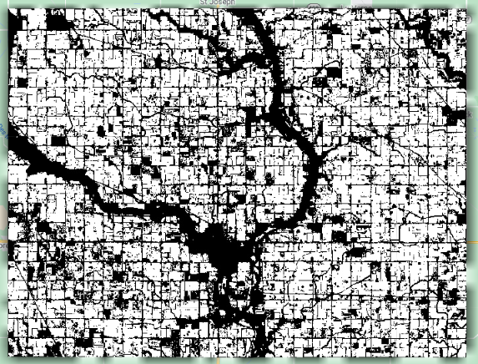
Data Extraction (features)
99 Counties
2013 - 2019
Crop Masking
Band-wise Histograms
Split by County
A data point is an array of size (histogram bins, bands), and there are (number of years) × (number of counties) of them ≈ 650 data points.
Notes:
Richard: Use the Cropland data layer to find areas with cultivated corn crops, and only generate band-wise histograms of a county with the valid pixels. Since we have 99 counties over the span of 7 years, that comes out to about 650 datapoints

Slide 9
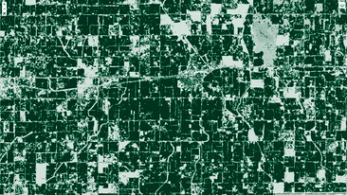
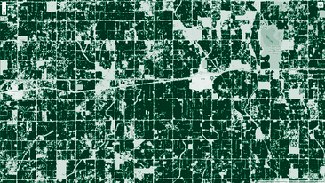
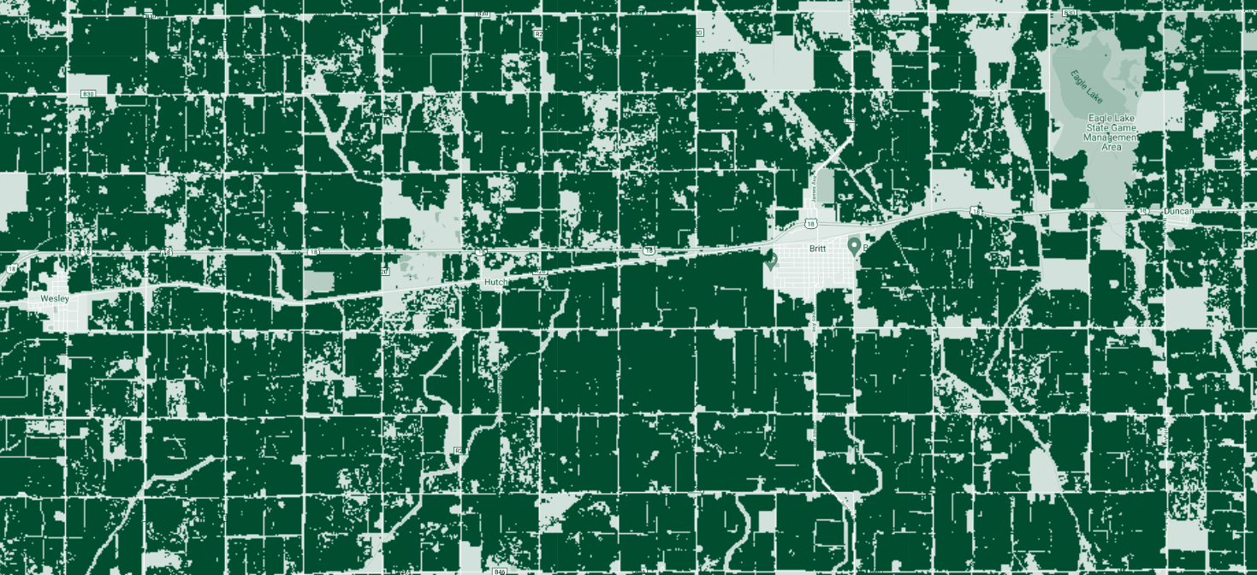
Crop Masking
Confidence
USDA NASS Cropland Data Layers
Confidence - pixel-wise confidence
97%
Cultivated - binary classification
Cultivated
Cropland - crop-specific land cover specification (crop types)
Corn - 1
Confidence & Cultivated
Confidence, Cultivated, & Corn

Slide 10
Histogramming
Challenges:
Fixed number of bins as input for a ml method
Spatial & temporal histogramming
Google earth engine makes neither of these convenient:
Histogram doesn’t guarantee bin number - need to use ‘fixed histogram’
Bands have different mins/maxs but fixed histogram accepts only one of each
Reducer works either spatially of temporally, but not both
Memory issues

Slide 11

GEE Pseudocode:
1. For each of the image products:
# get mins and maxs for each bands
2. Calculate band-wise mins and maxs
3. Bring them into numpy
# county specific
4. Grab the county shape
5. Clip the image collection the the county
# band-wise histogramming
6. For each of the bands:
7. Make a fixed histogram from the calculated min and max for the band
# spatial histogramming
8. Map the image collection to a feature collection with
# temporal histogramming
9. Aggregate all the histograms into one array
10. Bring into numpy
11. Sum across the time axis

Slide 12
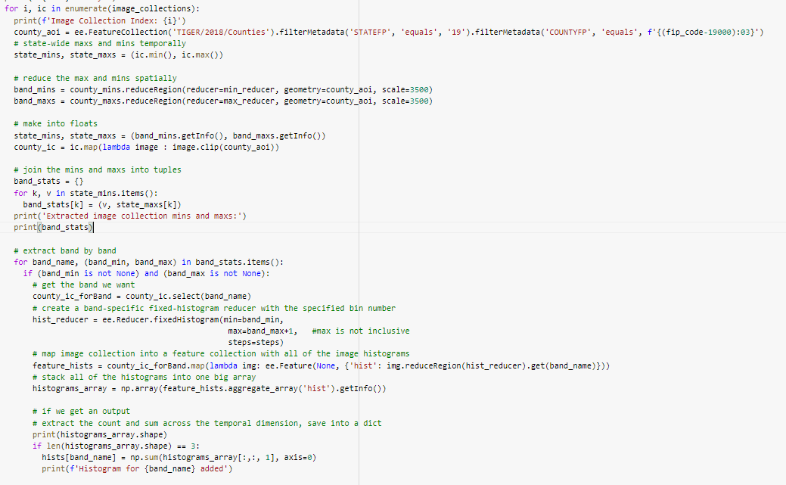
GEE Pseudocode:
1. For each of the image products:
2. Calculate band-wise mins and maxs
3. Bring them into numpy
4. Grab the county shape
6. For each of the bands:
7. Make a fixed histogram from the calculated min and max for the band
8. Map the image collection to a feature collection with
9. Aggregate all the histograms into one array
10. Bring into numpy
11. Sum across the time axis

Slide 13
More Issues
This is all well and nice, but...
One year takes a day to download (for only one image collection)
Not all data services are compatible (not reducing or too big) - we think the issue has to do with projections, but haven’t been able to solve it
Corrupted data (where the reducers don't work)
Notes:
could be projection issue

Slide 14
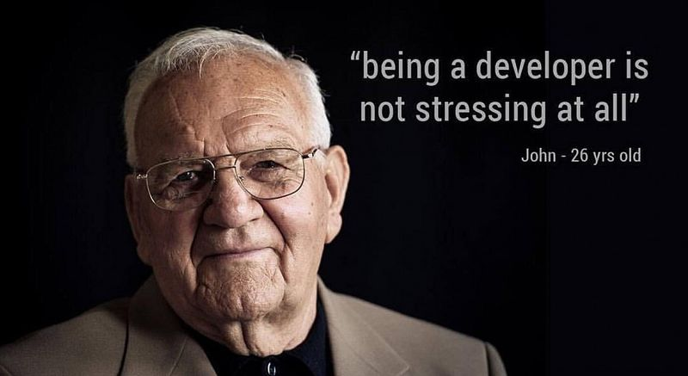
“Using Google Earth Engine is not stressful at all.”
Notes:
https://i.redd.it/scupjyjwyqs11.jpg

Slide 15

How we ended up doing it
Generated an Earth Engine Image Collection for each county, for each year, for each Earth Engine product
Used a parallelized script to download low resolution geotiffs (~5 days)
Richard’s computer died in the aftermath
Wrote a second script to load a stack of images from a year (optionally mask them) and then flatten them before using numpy to generate band-wise histograms
Richard, circa 2021, colorized
Notes:
https://media3.giphy.com/media/82MkOzEyyXeSLkgWyv/giphy.gif
downloaded lowest resolution

Slide 16
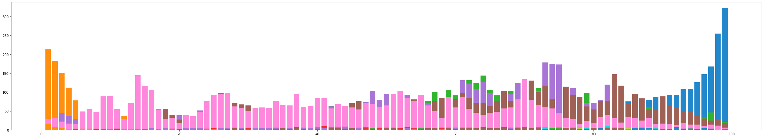
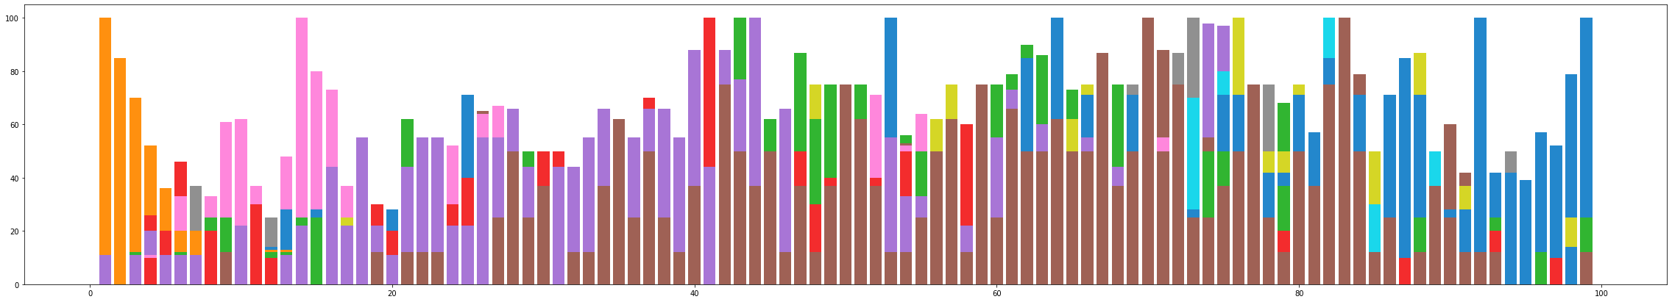
Normalization
Original ‘
Histogram-wise: percent of max ‘

Slide 17
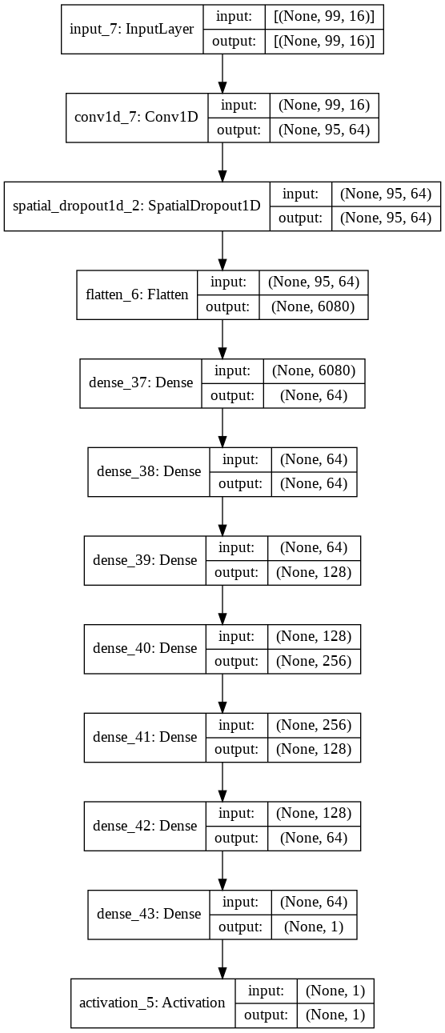
Model Design
Conv1D to take into account the 1D relationship between the histogram bins (1 was enough from our tests)
Spatial dropout for regularization
Our goal is to get small mean absolute error (MAE), but through empirical testing we saw that we get better results optimizing for mean square error (MSE)
MSE leads to a more aggressive optimization
Empirically tested and this model performed the best:
Val MSE: 203.6
Val MAE: 10.7 bushels/acre (std of yield is 27.1)
Notes:
Talk about conv1d and spatial dropout for regularization
Following layers are a dense layer in upside down u sahe

Slide 18
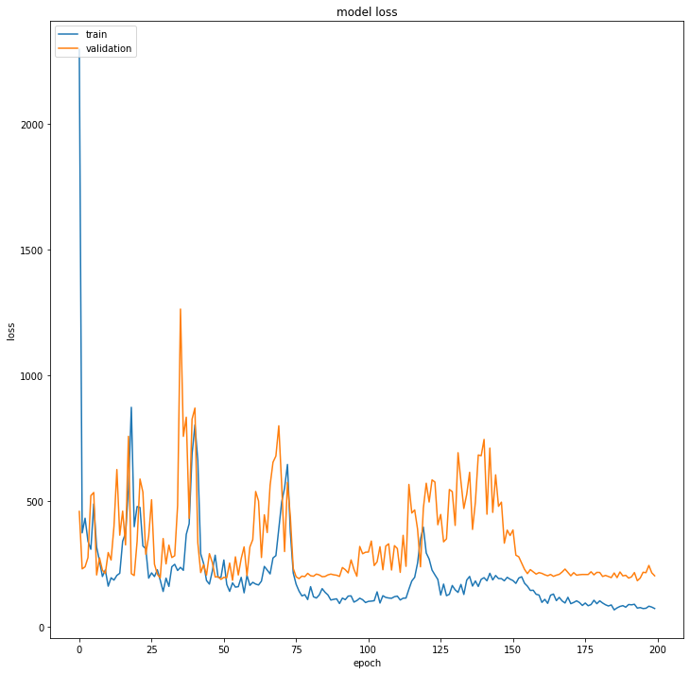
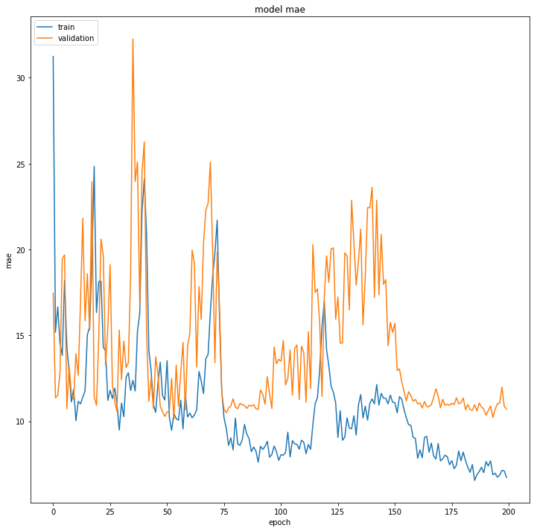
Training

Slide 19

Heatmap
Calhoun Prediction
Once we have a model that can predict aggregate yield from histogram, we can take the model and apply it to histograms at each pixel.
Assuming that a ‘high-yield’ pixel’s temporal histogram is similar to a high-yield county (and vice versa)
(Lighter is higher relative yield)
Notes:
Model predicts aggregate yield for a county, but that’s not necessarily useful as counties are large,
so we apply it to temporal histograms of individual pixels, which, since they are normalized in the same way, give us a relative yield metric that tells us how good a pixel is compared to others. A high yielding pixel’s temporal histogram should be similar to a high yielding county’s histogram

Slide 20
Conclusions
This type of project has promise: the model was able to train and more so the validation accuracy dropped
Such a model could be a viable method to evaluate the potential for non-cultivated land to grow corn
By using environmental data only, we are able to ignore effects of current crops on the model prediction
The model makes a key assumption that all things but the environmental conditions are consistent across all land, but this assumption may not hold
Personal Conclusions:
Getting good data is very difficult
Working with Google Earth Engine is a big headache

Slide 21

Future Work
Consider land cover classes for predictions (only look at places that crops can be planted, not a city or body of water for example)
Segment the data by land (i.e. soil) conditions
Use a more comprehensive set of bands from more data sources
Perform a rigorous band selection
Train model on higher resolution data
Use NDVI as an intermediate predictor for yield
Perform further analysis on what model to use for the overall analysis
Get yield of different crops
Different/more locations
Notes:
In the future, we would like to features at land cover classification data to avoid looking at regions that are completely unfeasible for crop planting, such as cities.
We might also consider segmenting land based on their soil or other properties that might not be visible from environmental properties
Increase the number of data sources and perform some form of feature selection to see which bands are useful
Also, we didn’t use spectral data, but we might want to look at a model that predicts NDVI based on environmental data, and then use that predicted NDVI as an input to another model to predict crop viability - allows us to get around the biasing we mentioned earlier
more crops
more locations

Slide 22
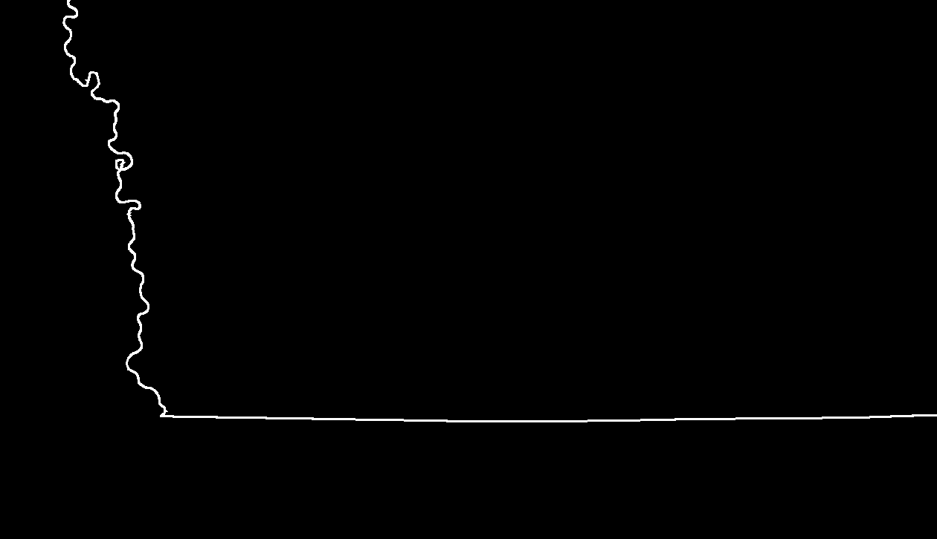
Thank You!

